Slide 1
Mode 2 Worker Registration

Slide 2
Once logged in via https://login.poweredbyonsite.com/
Select the Arrow Energy Mode 2 tile
Select Manage Roles From here you will be able to add your workers and or roles

Slide 3
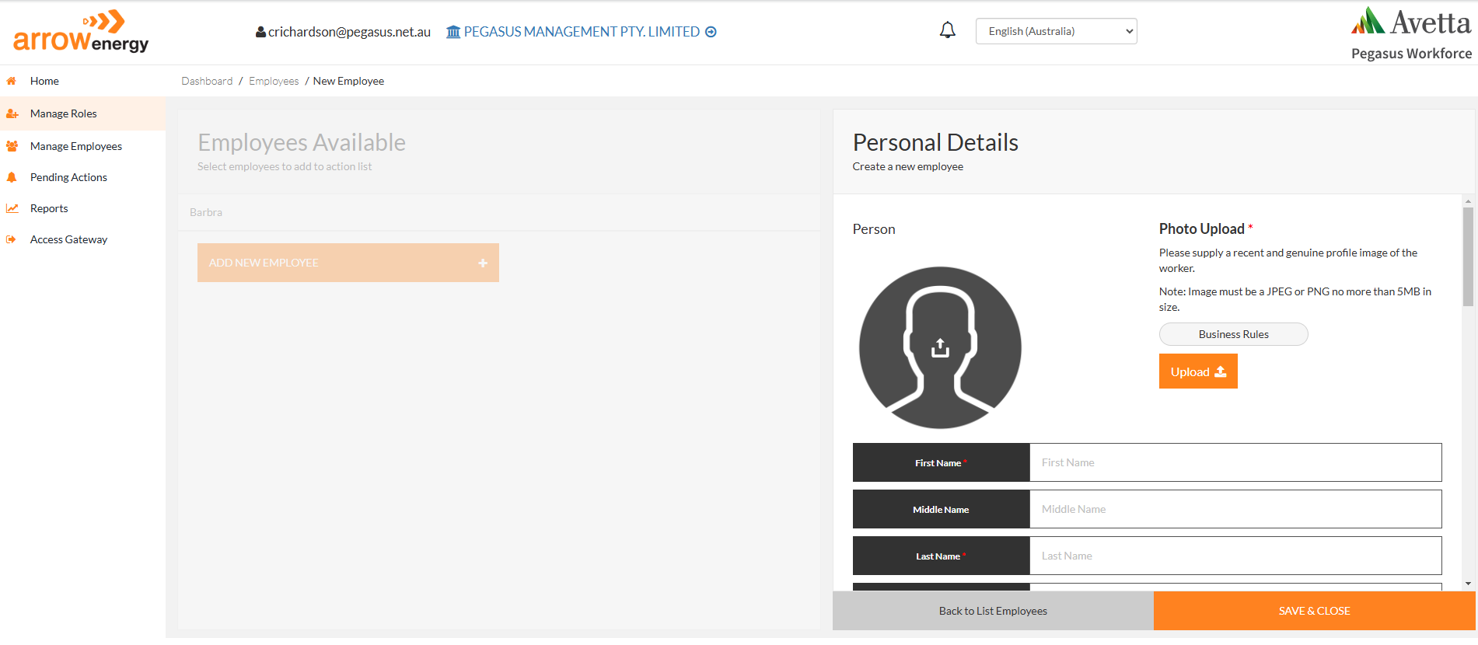
From ‘Manage Roles’ you will be able to see a list of all employees. If your employee is new you will need to add their details by selecting
‘Add New Employee’.
When adding a new worker you will need to provide the following mandatory details marked with *.
Photo of worker
First/Last name
DOB
Phone
Unique email
Also accept the T’s & C’s

Slide 4
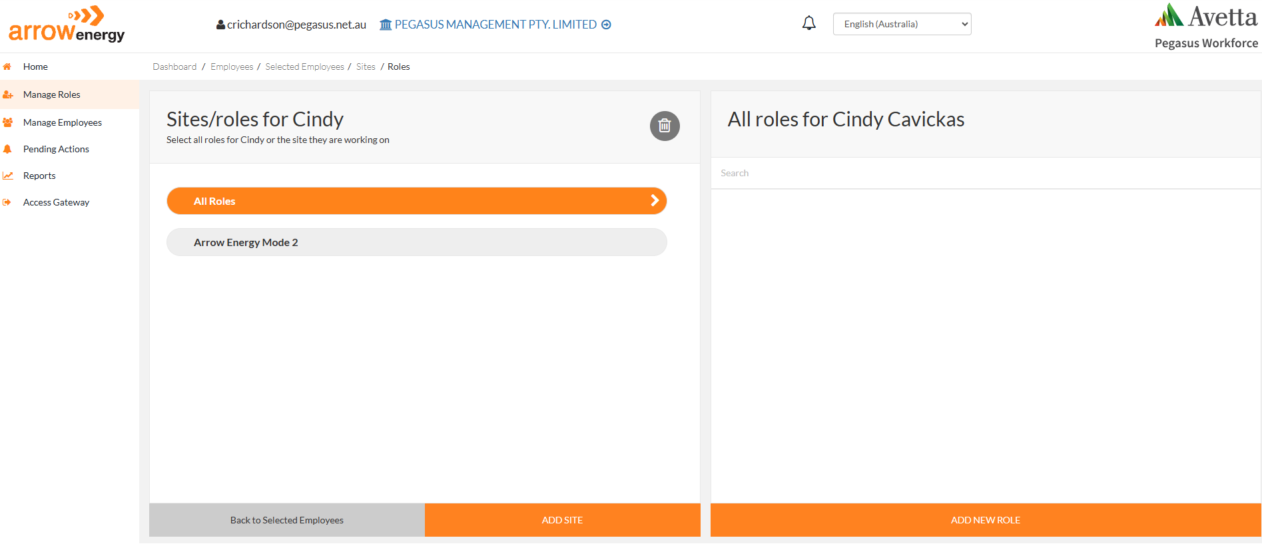
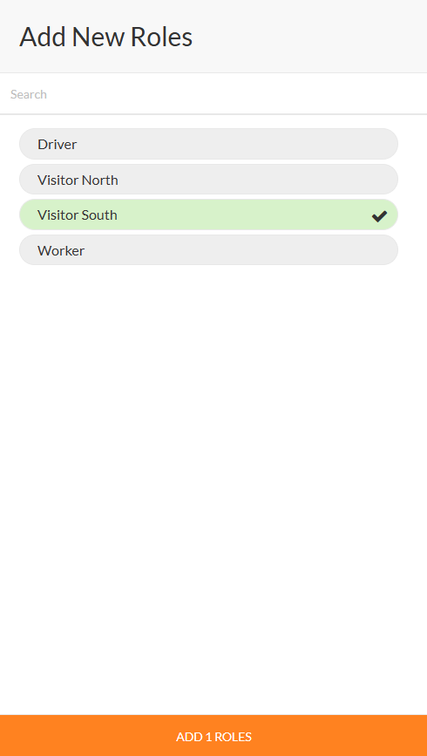
1
Once you have entered or selected your worker continue to add roles.
1.Select All Roles
2.Add New role
3. Select relevant role/s
4. Add roles
3
2
4

Slide 5
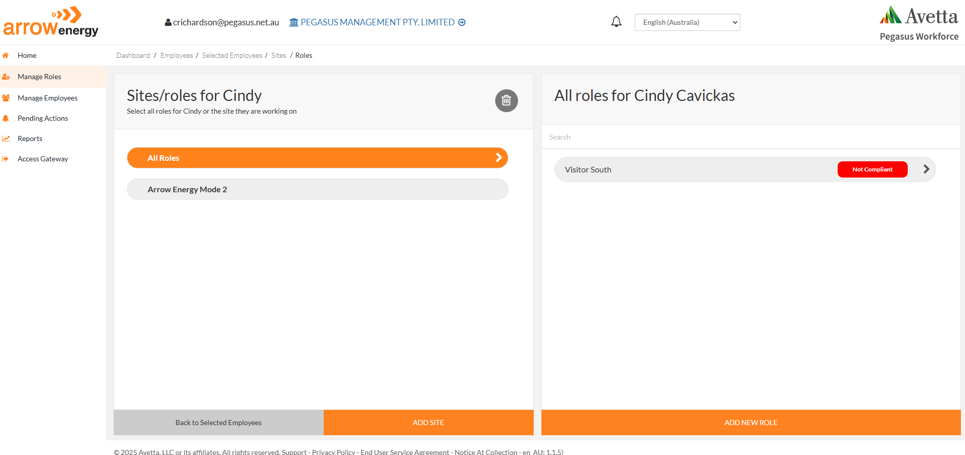
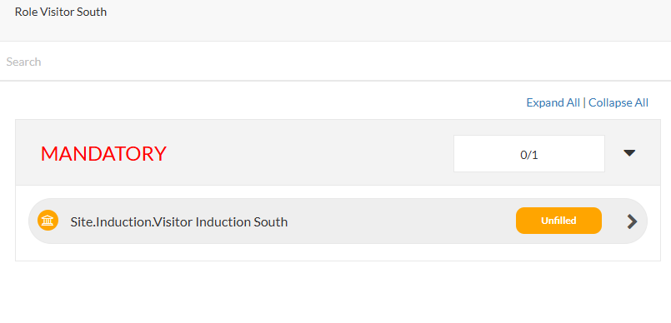
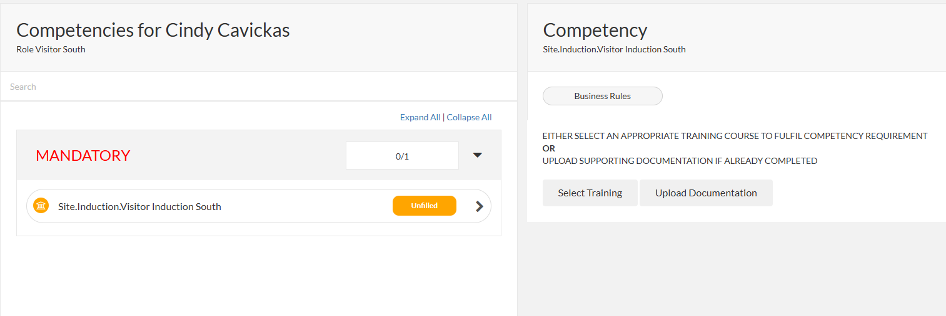
1
The role will show as non compliant 1.click the role
2.Click on each competency
3.Select Training
2
3

Slide 6
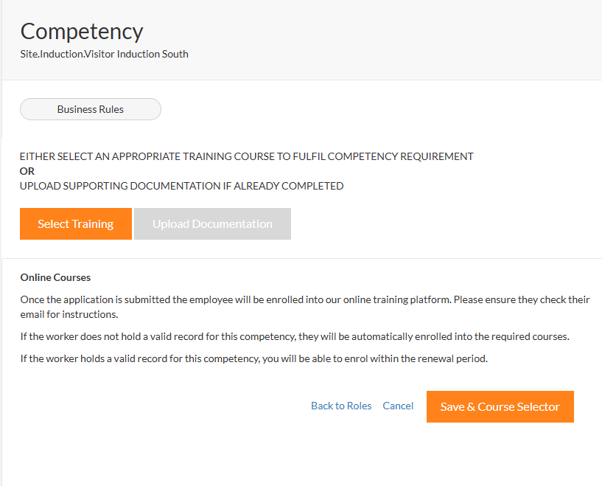
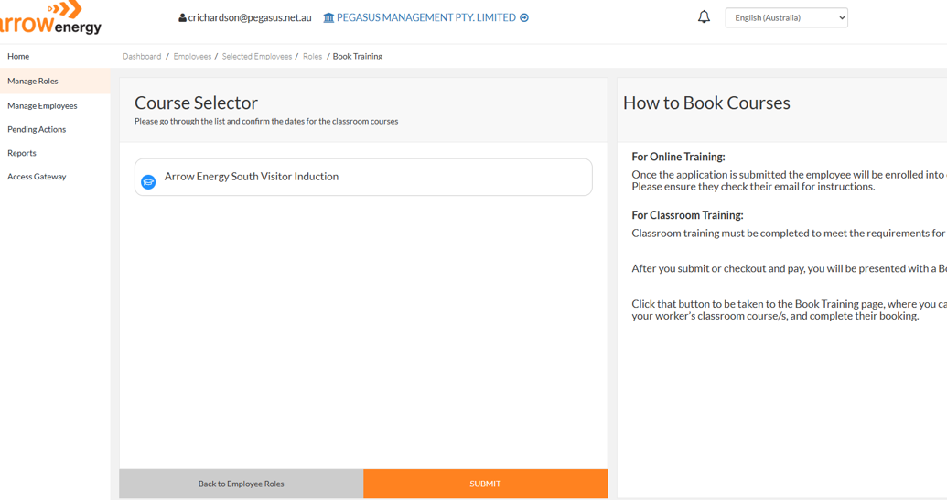
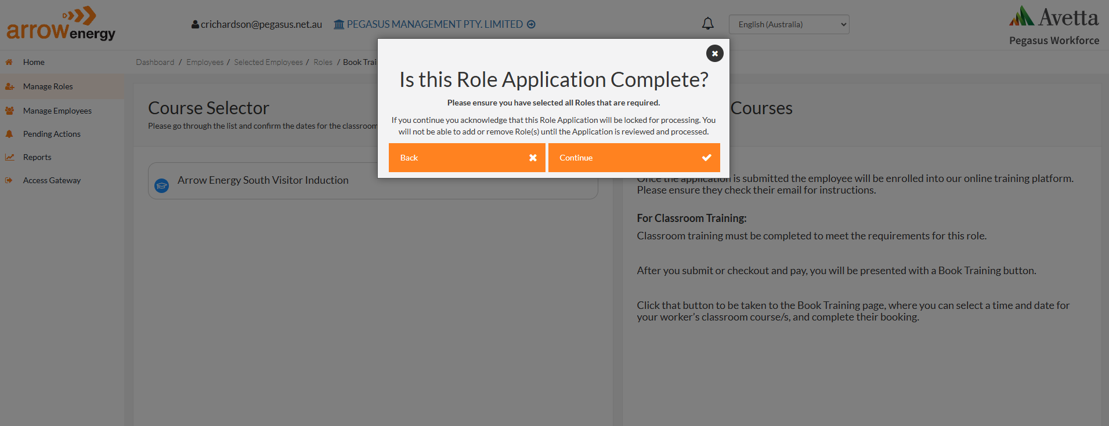
1
2
3
Once you have selected training
1.Continue the enrolment by selecting Save and Course Selector 2.Training will present select Submit
3.Application is complete select Continue

Slide 7
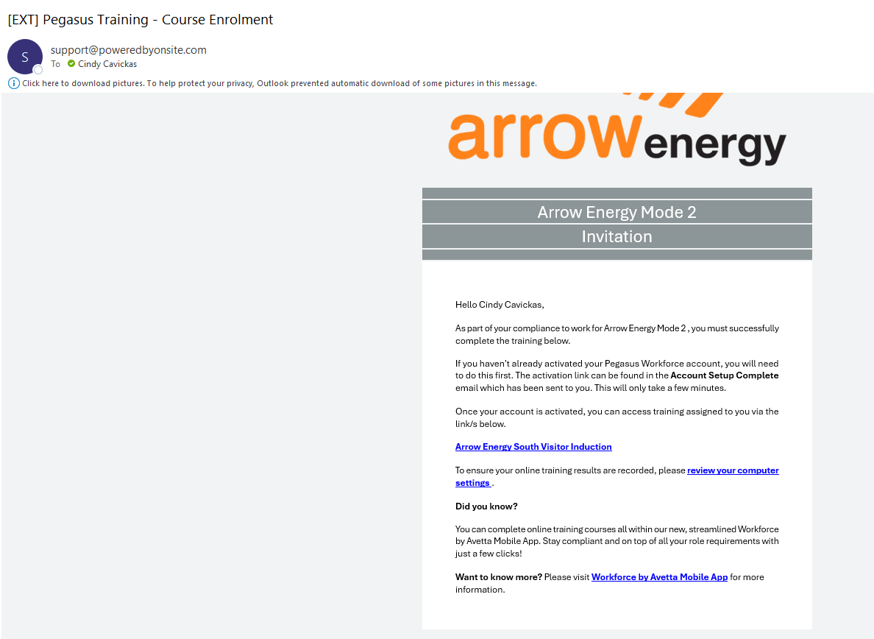
Your worker will receive an email from support@poweredbyonsite.com
They can access training via the link in the email or the Workforce mobile app.

Slide 8
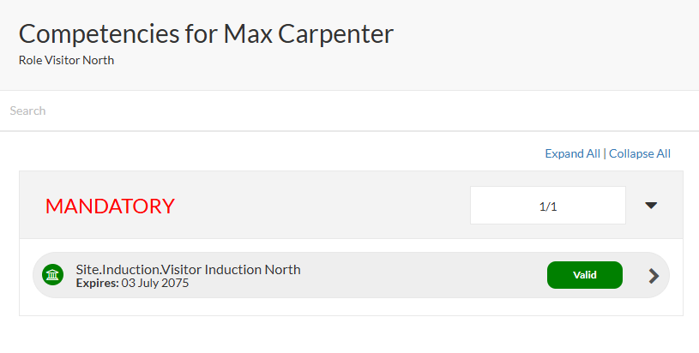
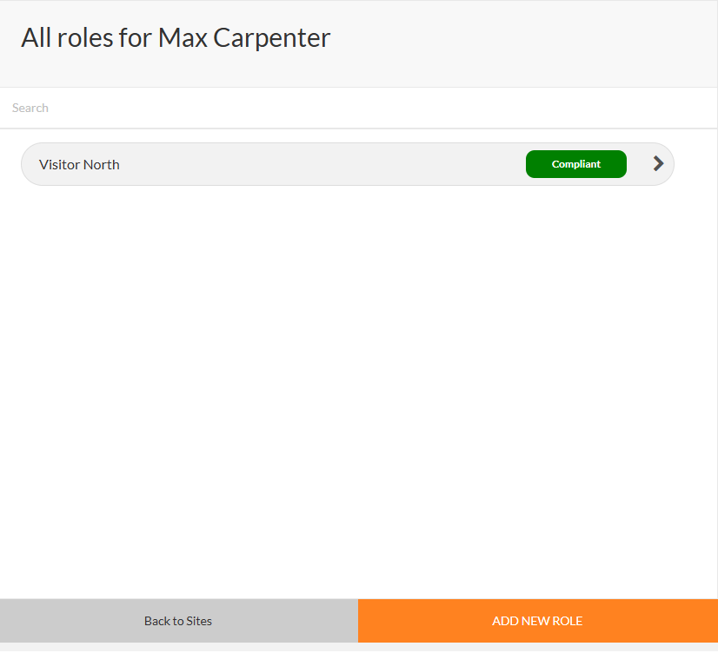
Once Training is completed by your worker, it will automatically update into the Client Portal showing as compliant.
There is nothing more to do!
1

Slide 9
FAQ’s
When adding a worker if you receive the below message the worker may already have a Pegasus profile please call Pegasus Workforce to have the worker added.
When selecting more than 1 role all roles must be fulfilled before the system will enroll into any training.
Contact Details
If you have any issues with any of the shown steps please contact Pegasus Workforce.
Phone: 1300 208 498
Email: energy@avetta.com

